Slide 1
OPER 618 Lesson 12 BLPP – An Exact Approach
Dr. Brian J. Lunday
Office: Rm 201E, Bldg 641

Slide 2
Let’s Start with these Questions
What is a convexification?
Why is it relevant?

Slide 3
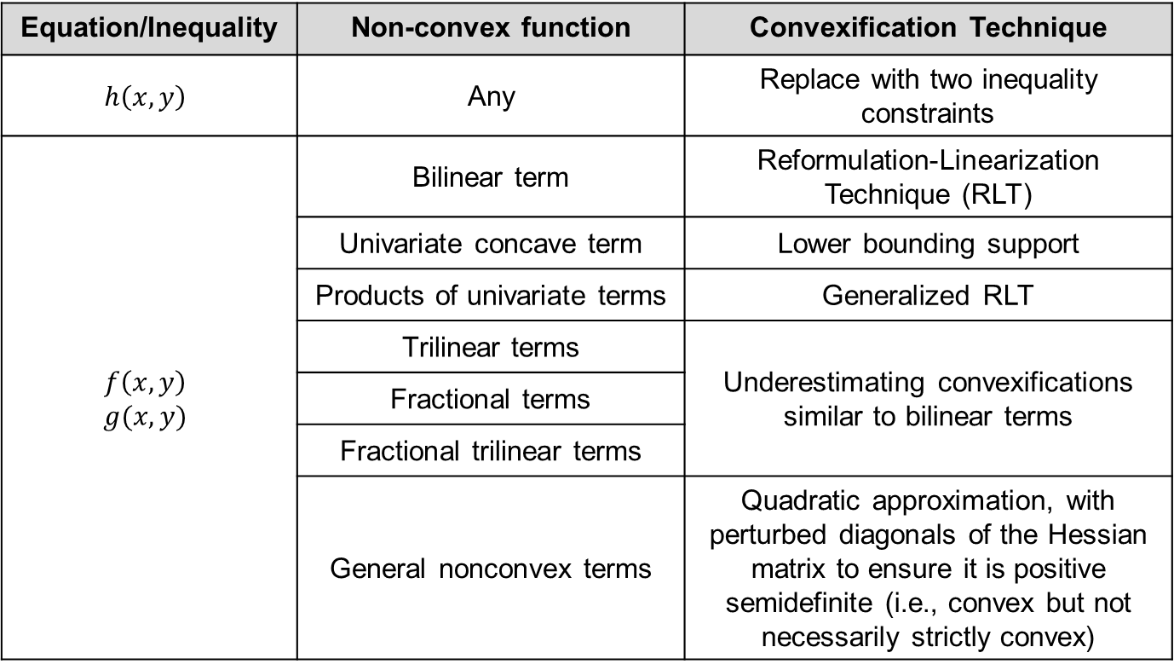
Convexification of Lower-level Problem via Relaxation
Equation/Inequality | Non-convex function | Convexification Technique
$$h\left(x,y\right)$$ | Any | Replace with two inequality constraints
$$f\left(x,y\right)$$ $$g(x,y)$$ | Bilinear term | Reformulation-Linearization Technique (RLT)
 | Univariate concave term | Lower bounding support
 | Products of univariate terms | Generalized RLT
 | Trilinear terms | Underestimating convexifications similar to bilinear terms
 | Fractional terms
 | Fractional trilinear terms
 | General nonconvex terms | Quadratic approximation, with perturbed diagonals of the Hessian matrix to ensure it is positive semidefinite (i.e., convex but not necessarily strictly convex)

Slide 4
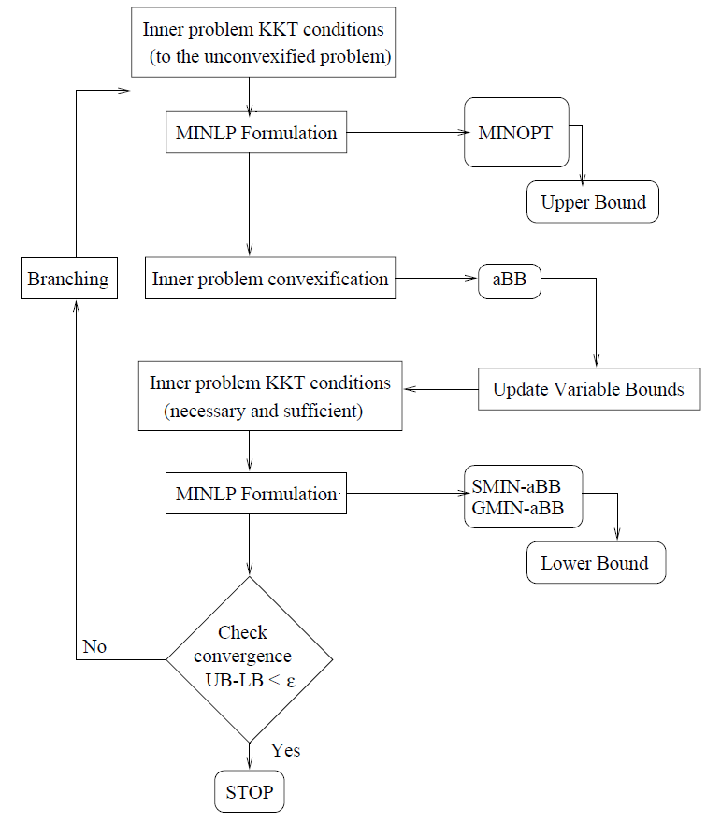
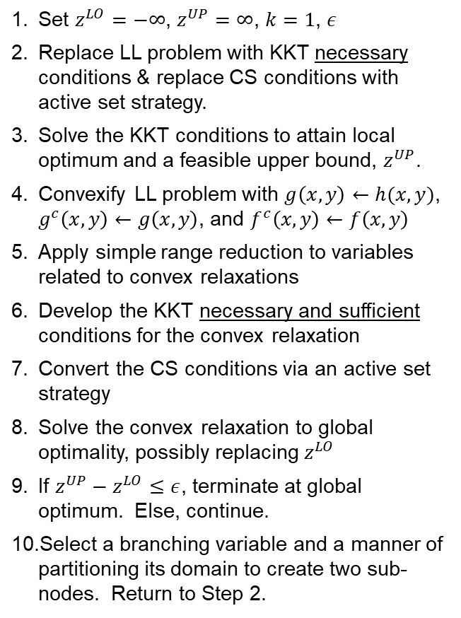
Branch-and-bound Approach
Set $z^{LO}=−∞$, $z^{UP}=∞$, $k=1$, $ε$
Replace LL problem with KKT necessary conditions & replace CS conditions with active set strategy.
Solve the KKT conditions to attain local optimum and a feasible upper bound, $z^{UP}$.
Convexify LL problem with $g\left(x,y\right)←h(x,y)$, $g^{c}\left(x,y\right)←g\left(x,y\right)$, and $f^{c}\left(x,y\right)←f\left(x,y\right)$
Apply simple range reduction to variables related to convex relaxations
Develop the KKT necessary and sufficient conditions for the convex relaxation
Convert the CS conditions via an active set strategy
Solve the convex relaxation to global optimality, possibly replacing $z^{LO}$
If $z^{UP}−z^{LO}≤ε$, terminate at global optimum. Else, continue.
Select a branching variable and a manner of partitioning its domain to create two sub-nodes. Return to Step 2.

Slide 5
Computational Studies
Example | LL Problem Characteristics
 | Objective function | Constraints
1 | Convex | Linear
2 | Linear | Convex
3 | Fractional (Linear after xfm) | Linear (Bilinear after xfm)
4 | Quadratic | --
5 | Nonlinear, nonconvex | Nonlinear, nonconvex

Slide 6
Caveats
LL problem must have (continuous) twice differentiable functions
Must have a global optimization (MINLP) solver

Slide 7
Questions & Discussion

